Slide 1
Approach for Determining the Background Library Spectra Using a Pulsed D-T Source
Vincent DiNova
NC State University
2018 CNEC Workshop
February 8-9, 2018
Raleigh, North Carolina

Slide 2
Table of Contents
Monte Carlo Library Least Squares (MCLLS)
Previous methods of determining background
Pulsed Neutron Generator (PNG) die-off time
Determining background using PNG
KSU/RDRS equipment capabilities
Next Steps
Discussion/Questions

Slide 3
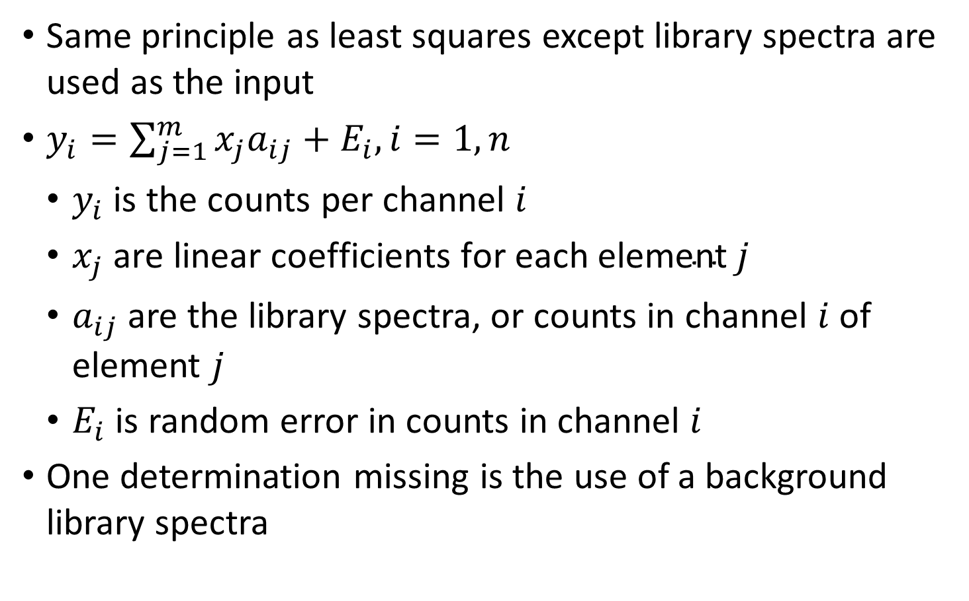
Monte Carlo Library Least Squares
Same principle as least squares except library spectra are used as the input
$y_{i}=\sum_{j=1}^{m}{x_{j}a_{ij}+E_{i}, i=1,n}$
$y_{i}$ is the counts per channel $i$
$x_{j} \text{are} \text{linear} \text{coefficients} \text{for} \text{each} \text{element} j$
$a_{ij}$ are the library spectra, or counts in channel $i$ of element $j$
$E_{i}$ is random error in counts in channel $i$
One determination missing is the use of a background library spectra

Slide 4
Previous Methods for Determining Background
Take background counts with a separate tool, or on a separate run
Neither option cost effective
Residual analysis
Perform original MCLLS fitting
Using residuals, determine missing elements/libraries
Add elements/libraries to MCLLS for final fitting
Not a true on-line analysis technique
Generate “best guess” background composition libraries
Using individual nuclides
Adds complexity to MCLLS calculation
Using semi-empirical background fitting functions

Slide 5
Pulsed Neutron Generator (PNG) die-off time
Pulse from PNG
Increase in gamma rays from inelastic scatter and neutron capture
After 15-20 microseconds, inelastic gamma rays no longer contribute to total spectrum
Neutron capture gamma rays continue exponential decrease until next pulse

Slide 6
Determining Background Using PNG
Utilizing complex timing equipment, multiple spectra can be generated during the same pulsing sequence
The burst spectrum is taken while the PNG is emitting fast neutrons, and includes both capture and inelastic gamma rays
The capture spectrum is taken just after the PNG is deactivated, when only neutron capture gammas are being emitted
After repetitive pulsing over a few milliseconds, a background spectrum can be collected before beginning the pulsing sequence again

Slide 7
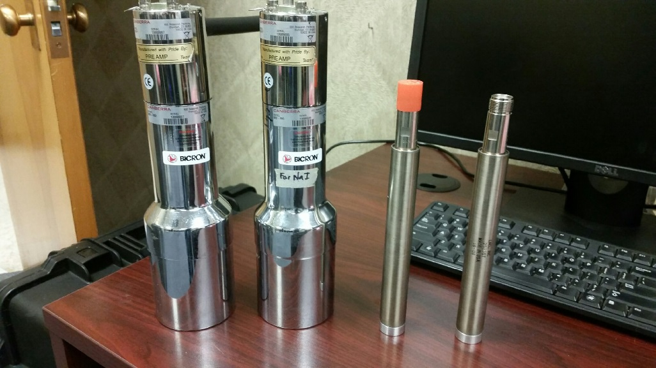
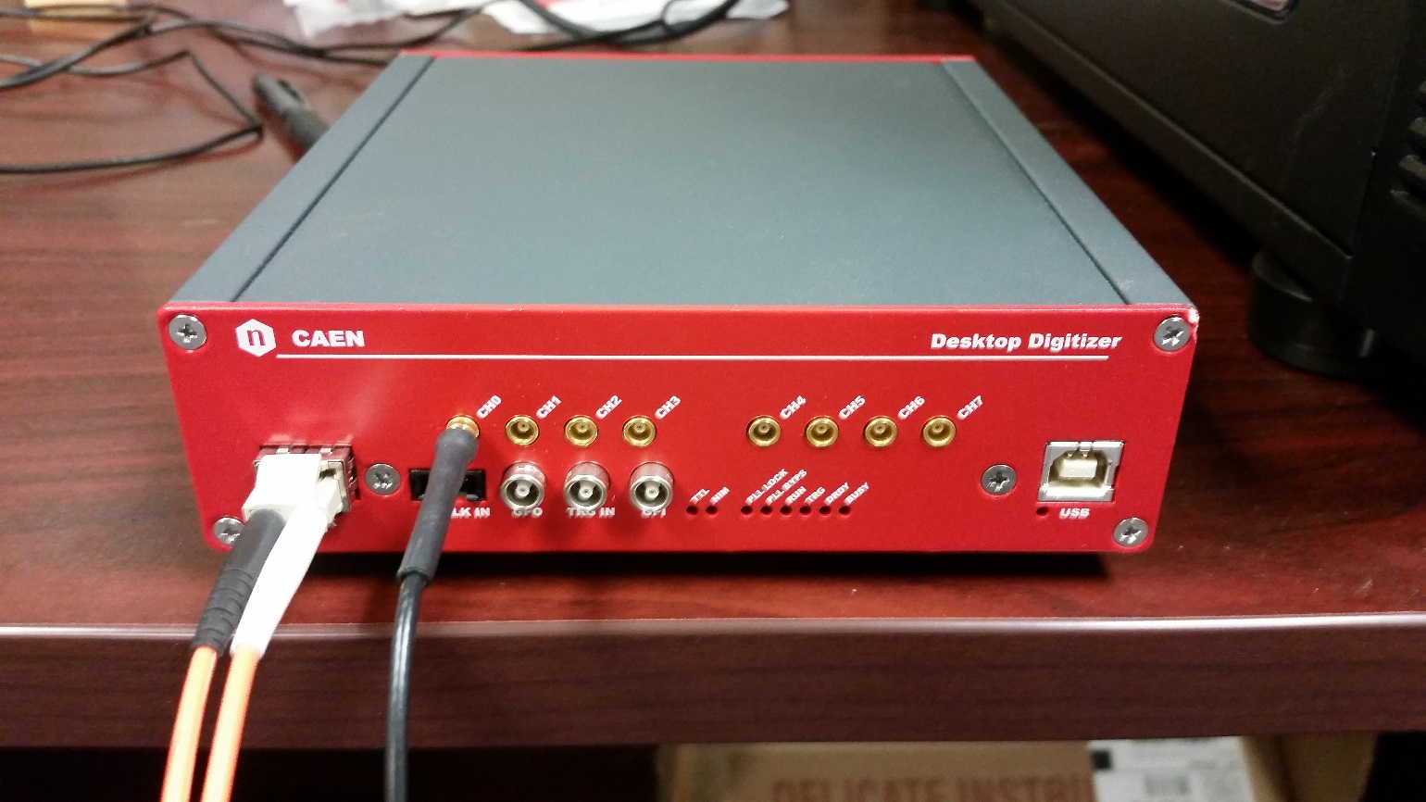
KSU/RDRS equipment capabilities
CAEN desktop digitizer
Model DT5730B
Thermofisher B320 D-T Generator
Canberra 2007P NaI(Tl) detectors
3”x3”
LND 252 He-3 detectors
1”x8"

Slide 8
Next Steps
Run preliminary tests to generate data
Very large data files
Determine best method to parse data into usable form that is also sharable
Optimize timing sequence to gather only pertinent information in each timing segment
Apply technique to full D-T cases at KSU testing facility

Slide 9
Questions/Discussions?
CAEN. User Manual UM3148. (2016).
Gardner, Robin P., Xu, Libai, “Status of the Monte Carlo Library Least-Squares (MCLLS) Approach for Non-Linear Radiation Analyzer Problems.” Radiation Physics and Chemistry. 78. (2009).
Mildenberger, Frank, Mauerhofer, Eric, “Cyclic Neutron Activation Analysis of Large Samples with a Pulsed 14 MeV Neutron Source.” Journal of Radioanalytical and Nuclear Chemistry. 311. (2017).
Tan, H. et al.,”A Digital Spectrometer Approach to Obtaining Multiple Time-Resolved Gamma-Ray Spectra for Pulsed Spectroscopy.” Nuclear Instruments and Methods in Physics Research B. 263. (2007).
Tan, H. et al.,”A Multiple Time-Gated System for Pulsed Digital Gamma-Ray Spectroscopy.” Journal of Radioanalytical and Nuclear Chemistry. Vol. 276, No. 3. (2008).

